Slide 1
Predicting Stock Market Prices from Population Age Demographics
“The H.A.V.E. Nots”:
Adrienne Smith, Harrison Fowler, Vwerosuo Uzezi, Eric Cooney
28 July 2018

Slide 2
Project Introduction
Our project is designed to explore a possible correlation between the age demographic of the US population (e.g. the baby-boomer generation) and US equity prices (S&P 500). Specifically, we will examine equity prices as reflected in the S&P 500 P/E ratios and a ratio of ‘Middle’ / ‘Older’ people in the US population from 1950 – 2017. ‘Middle’ being between 40-49 and ‘Older’ being between 60-69 yrs old.
Our hypothesis suggests a correlation between M/O and P/E such that:
Equity prices will tend to rise as the M/O ratio increases as the ‘M’ group accumulates assets during high-earning years (i.e. 40-49)
Equity prices will tend to fall as the M/O ratio decreases as the ‘O’ group sells assets during retirement years (i.e. 60-69)
Null Hypothesis: There is no statistically significant correlation between the changing US age demographic (M/O) and US equity prices (P/E)
We will then develop a model to predict future US equity prices based on the projection of age demographic for the US population (2018 – 2060)
Data for the US Population was sourced from the OECD (1950 – 2060) (https://stats.oecd.org/Index.aspx?DataSetCode=POP_PROJ)
Data for the S&P 500 P/E Ratios was sourced from Yale University (1950 – 2017): (http://www.econ.yale.edu/~shiller/data.htm )

Slide 3
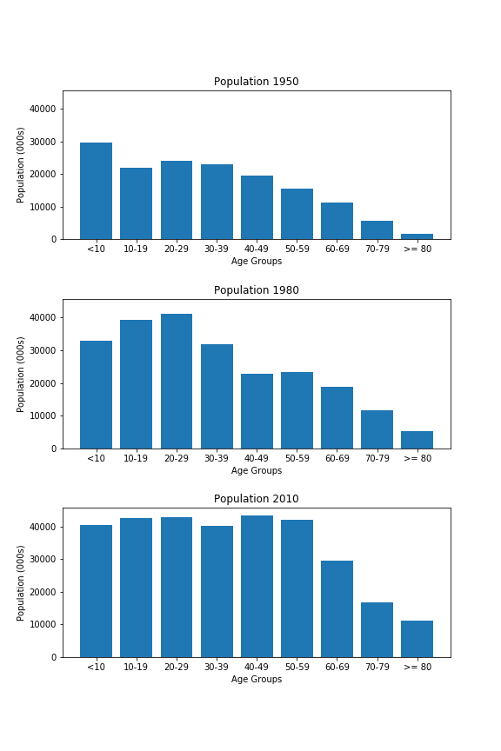
Data Analysis
Population
While the population as a whole is growing (same y-axis), you can see the 'wave' of the boomer generation aging across # these charts.
Baby-boom generation (1946-1964)
3

Slide 4
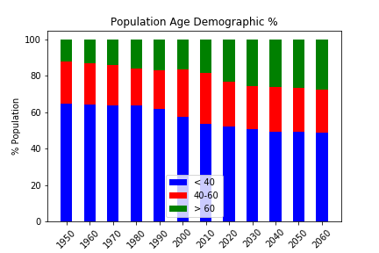
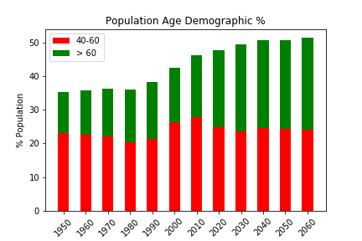
Data Analysis – U.S. Age Demographic
Represent the historical actuals and projected U.S. population age demographic from 1950 – 2060
Note the ‘bulge’ as the baby-boom generation ages beyond 2000 as reflected in the green columns

Slide 5
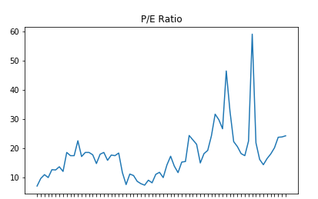
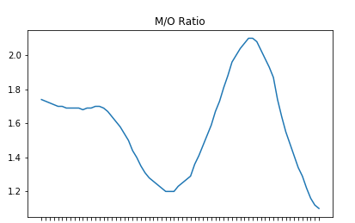
Data Analysis: Primary Data Sets
Housing Bubble
Internet Bubble
1950
1960
1970
1980
1990
2000
2010
1950
1960
1970
1980
1990
2000
2010
P/E Ratio S&P 500
Ranges from 7.0 to 59.0
2 Distinct macro bubbles
Possible outliers
M/O Ratio
‘M’ : Population 40 – 49
‘O’: Population 60 – 69
Ranges from 1.1 to 2.1

Slide 6
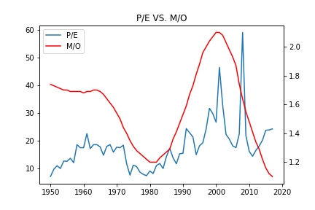
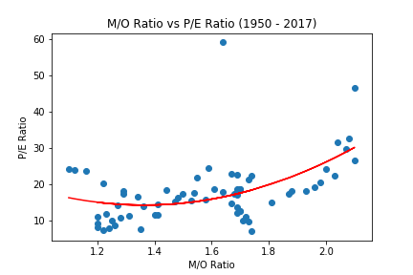
Data Analysis – Putting it together
Housing Bubble
Internet Bubble
Time – Series Overlay
Scipy stats →Pearson Correlation
R-value = .44
P-value = 1.61 x 10⁻⁴ (0.000161)
Moderate correlation which is statistically significant
Reject the null hypothesis (‘There is no correlation between P/E and M/O’)
Scatter Plot
Outliers visually obvious
Visually apparent correlation

Slide 7
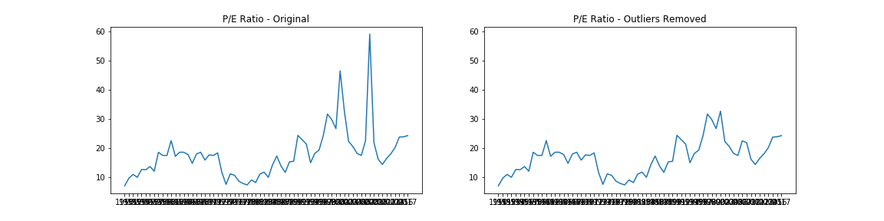
Data Preparation – Drop Outliers
Housing Bubble
Internet Bubble
1950
1960
1970
1980
1990
2000
2010
1950
1960
1970
1980
1990
2000
2010
Explore Z-scores
Z-score → a measure of the number of standard deviations from the mean
Drop Z-scores more than 3 standard deviations from the mean → removes Internet & Housing Bubbles
Internet Bubble: Z-score 3.4
Housing Bubble: Z-score 4.9
Note: 3 standard deviations represents 97.5% of data → retain model integrity

Slide 8
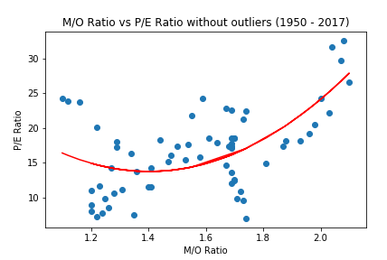
Data Preparation – Drop Outliers
Scatter Plot
Repeat the Scipy stats →Pearson Correlation
R-value = .50
P-value = 2.40 x 10⁻⁵ (0.000024)
Moderate correlation which is statistically significant
Reject the null hypothesis (‘There is no correlation between P/E and M/O’)

Slide 9
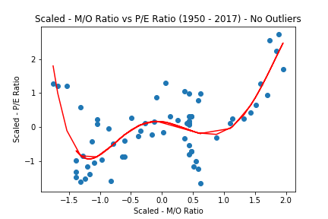
Data Preparation – Scale Data
Scatter Plot
As pre-requisite to input the data in a machine learning model to derive the prediction, necessary to scale the data
Scaled data has zero mean and unit variance (i.e. variance = 1)
Note the 5th degree polynomial regression line to fit the data

Slide 10
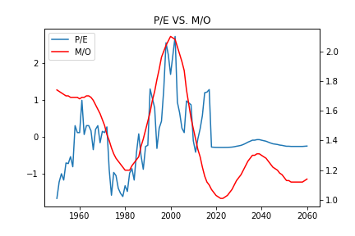
Model Prediction
 | Linear Regr | Poly. Regr.
MSE | 0.45 | 0.50
R-squared | 0.56 | 0.50
Separated data to training & test data (85% / 15%)…performed a random selection of data not just ‘last 15%’
Develop a linear regression model and fit to test data
Develop a polynomial regression model and fit to test data
Assessed the predictive capabilities of these models (relative to test data)
Applied the model to the future M/O data (originally obtained from OECD) to derive the above P/E projection
Model needs further analysis

